Slide 1
Module 2
Principles and Techniques

Slide 2
Predictive modeling
Predictive modeling is a mathematical process used to predict future events or outcomes by analyzing patterns in a given set of input data.
Predictive modeling is the process by which a model is created or chosen to try to best predict the probability of an outcome.
Examples of predictive modeling include estimating the quality of a sales lead, the likelihood of spam or the probability someone will click a link or buy a product.

Slide 3
Types of predictive models
Propensity models (predictions)
Clustering models (segments)
Collaborative filtering (recommendations)

Slide 4
Propensity Model
Propensity Modeling is a statistical technique used to predict the chances of certain events happening in the future.
Propensity modeling is an approach that attempts to predict the likelihood that visitors, leads, and customers will perform certain actions.
Propensity models make predictions about a customer’s future behavior. With propensity models you can anticipate a customers’ future behavior.
However, keep in mind that even propensity models are abstractions and do not necessarily predict absolute true behavior.
For example, a propensity model can help a marketing team predict, through data science or machine learning, the likelihood that a lead will convert to a customer. Or that a customer will churn. Or even that an email recipient will unsubscribe

Slide 5
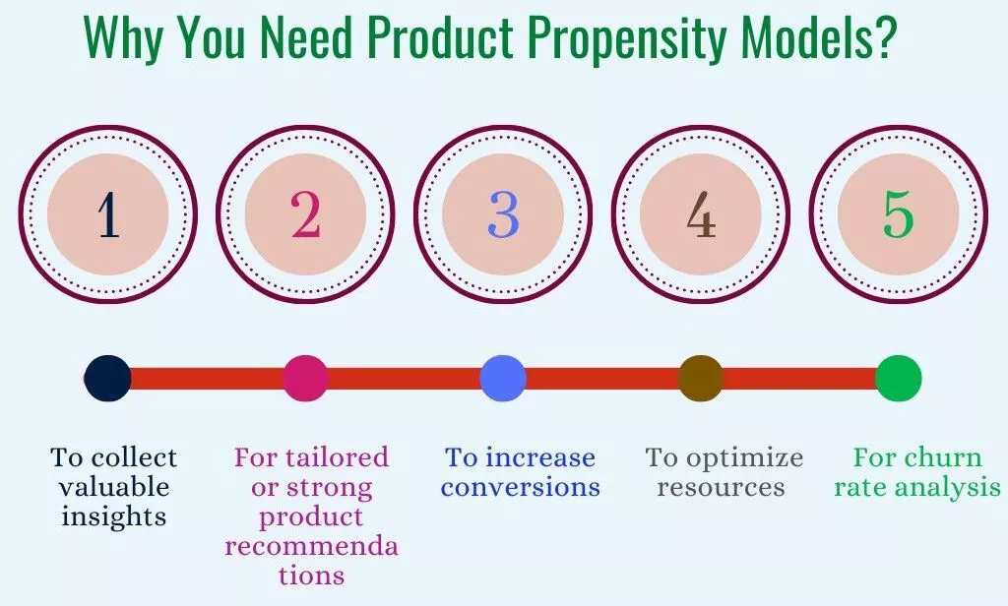

Slide 6
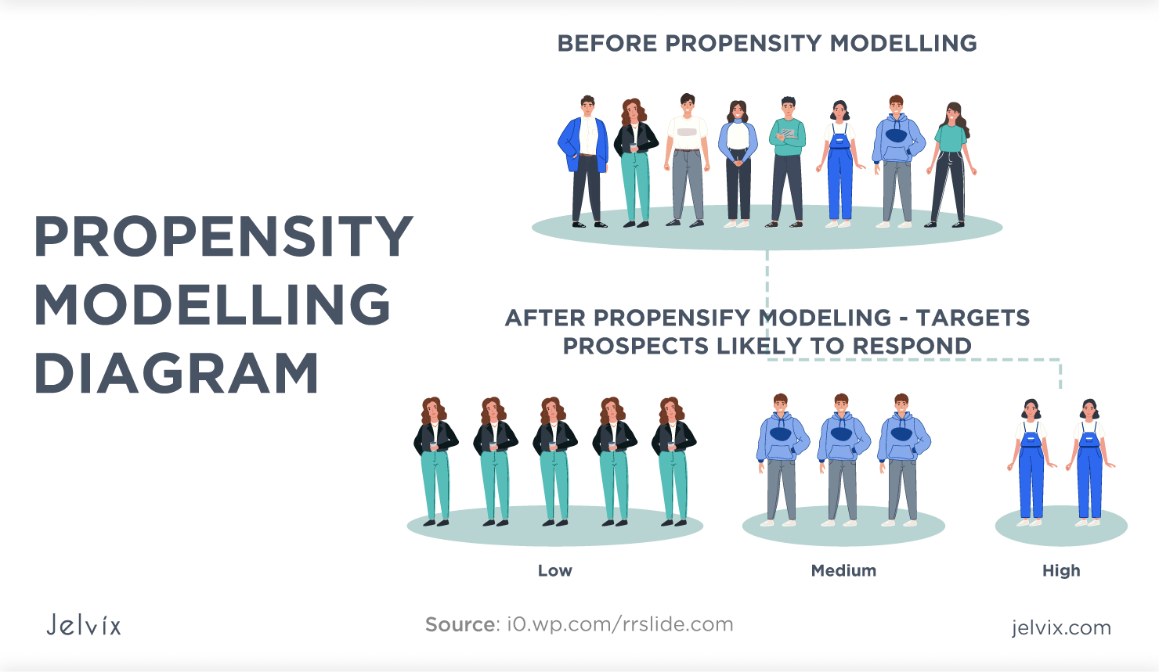

Slide 7
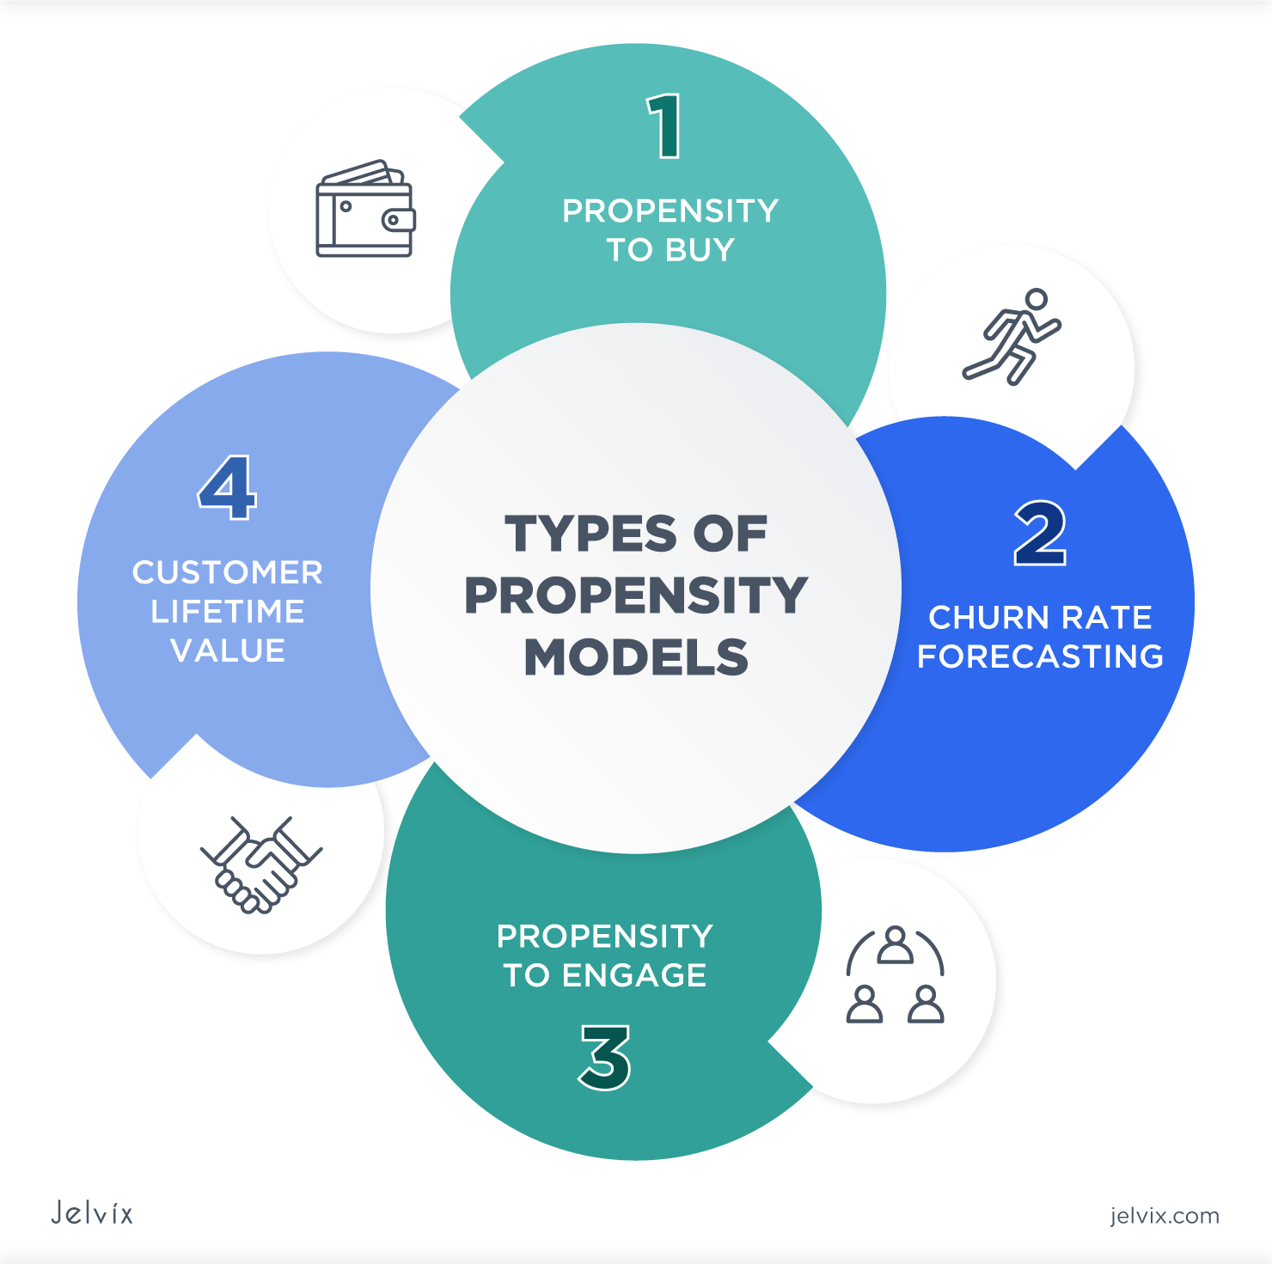

Slide 8
Propensity Models
Model 1: Predicted customer lifetime value (CLV)
CLV (Customer Lifetime Value) is a prediction of all the value a business will derive from their entire relationship with a customer.
The Pareto Principle states that, for many events, roughly 80% of the effects come from 20% of the causes.
When applied to e-commerce, this means that 80% of your revenue can be attributed to 20% of your customers.
While the exact percentages may not be 80/20, it is still the case that some customers are worth a whole lot more than others, and identifying your
“All-Star” customers can be extremely valuable to your business. Algorithms can predict how much a customer will spend with you long before customers themselves realizes this.

Slide 9
Predicted customer lifetime value (CLV)
Customer lifetime value helps you understand and gauge current customer loyalty. If customers continue to purchase from you time and time again, that’s usually a good sign that you’re doing the right things in your business.
Customer lifetime value is a gauge of the profit associated with a particular customer relationship, which should guide how much you are willing to invest to maintain that relationship. That is, if you estimate one customer’s CLV to be $500, you wouldn’t spend more than that to try and keep the relationship.
The simplest way to calculate CLV is:
CLV = average value of a purchase x number of times the customer will buy each year x average length of the customer relationship (in years)

Slide 10
Model 2: Predicted share of wallet
It indicates what percentage of a consumer's total expenditures on a specified product/service goes to buying Company X's brand. Share of wallet is a practical measure of how well a company's product or service is competing in the marketplace.
Share of wallet (SOW) is a marketing metric used to calculate the percentage of a customer's spending for a type of product or service that goes to a particular company.
For example, if a customer spends $60 a month at fast food restaurants, and $30 of that amount is spent at McDonald's, McDonald's has a 50% SOW for that customer. The term is sometimes expressed as wallet share.

Slide 11
Model 3: Propensity to engage
A propensity to engage model predicts the likelihood that a person will engage in some activity, like unethical behavior or post purchases.
For example, a propensity to engage model can predict how likely it is that a customer will click on your email links.
Armed with this information you can decide not to send an email to a certain “low likelihood to click” segment

Slide 12
Model 4 : Propensity to Unsubscribe
A propensity to unsubscribe model predicts how likely it is that a customer will unsubscribe from your email list at any given point in time.
Armed with this information you can optimize email frequency. For “high likelihood to unsubscribe” segments you should decrease send frequency, whereas for “low likelihood to unsubscribe” segments you can increase email send frequency.
You could also decide to use different channels (like direct mail or LinkedIn) to reach out to “high likelihood to unsubscribe” customers

Slide 13
Model 5 : Propensity to buy
The propensity to buy model tells you which customers are ready to make their purchase, so you can find who to target. Moreover, once you know who is ready and who is not helps you provide the right aggression in your offer.

Slide 14
Those that are likely to buy won’t need high discounts while customers who are not likely to buy may need a more aggressive offer, thereby bringing you incremental revenue.
E-commerces experience very regular website traffic and every single visitor is a potential customer. A Propensity to Buy Model predicts which of these visitors (potential customers) are going to purchase something and which are not.

Slide 15
What Makes it Important?
E-commerce websites attract a huge amount of traffic. Ever wonder how many actually end up buying something?
On average 2% of the visitors actually buy something. These visitors have certain behaviors that distinguish the ones that buy something and the ones that don’t.
These visitors can be modeled using their website visit behavior to predict their likelihood to purchase something. This has two hidden benefits:
The company can differentiate visitors that are highly likely to buy something along with their behaviors.
They can target these highly likely visitors to take immediate marketing actions like; campaigns, coupons promotions, etc

Slide 16
Model 6 : Propensity to churn
Propensity to churn model estimates the likelihood of a customer to leave in the next period of time.
It uses the data about the customer, such as their service level, tenure, payment history, as well as demographics to predict the probability of discontinuing the relationship
It’s a binary classifier that divides clients into two groups (classes) — those who leave and those who don’t.
In addition to assigning them to one of the two groups, it will typically give us the probability with which the client belongs to that group

Slide 17
It is important to note that this is the probability of belonging to the group of clients who leave.
What is it useful for?
By knowing which clients are at the highest risk of leaving, we can better target our rescue efforts.
For example, we can reach out to these clients with a marketing campaign, reminding them that they haven’t purchased from us in a while, or even offering them a benefit.

Slide 18
The propensity to churn model tells you which active customers are at risk, so you know which high value, at risk customers to put on your watch list and reach out.
Armed with this information, you may be able to save those customers with preemptive marketing programs designed to retain them.
Often propensity models can be combined to make campaign decisions. For example, you may want to do an aggressive customer win back campaign for customers who have both a high likelihood to unsubscribe and a high predicted lifetime value

Slide 19
Cluster Models
Clustering is the predictive analytics term for customer segmentation. Clustering, like classification, is used to segment the data.
Unlike classification, clustering models segment data into groups that were not previously defined
Cluster analysis itself is not one specific algorithm, but the general task to be solved.
It can be achieved by various algorithms that differ significantly in their notion of what constitutes a cluster and how to efficiently find them.

Slide 20
Clustering models focus on identifying groups of similar records and labelling the records according to the group to which they belong.
While clustering is useful for data analysis and as a pre-processing step for a number of learning tasks, we are interested in the specific pre-processing task of using clustering to gain more information about the data to improve prediction accuracy.

Slide 21
Model 7: Behavioral clustering
Behavioral clustering informs you how people behave while purchasing. Do they use the web site or the call center? Are they discount addicts? How frequently do they buy? How much do they spend? How much time will go buy before they purchase again?

Slide 22
This algorithm helps set the right tone while contacting the customer. For instance, customers that buy frequently but with low sized orders might react well to offers like ‘Earn double rewards points when you spend $100 or more

Slide 23
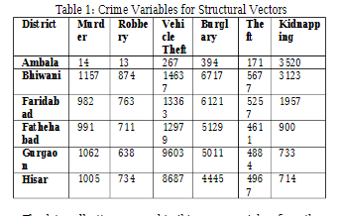
Behavioral clustering can also informs us on other behaviors, such as crime and is used in performing crime analysis

Slide 24
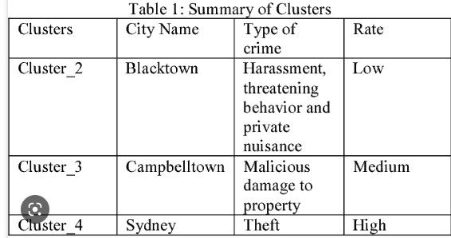

Slide 25
Model 8: Product based clustering (also called category based clustering)
Product based clustering algorithms discover what different groupings of products people buy from.
The following use cases describe how product-based clusters help you produce relevant and personalized touches, thereby increasing customer engagement and reducing marketing costs:
More targeted product or brand campaigns
When creating a product-focused campaign, quickly identify and target the customers or clusters that have previously purchased these products. Such campaigns help to increase affinity toward the products that customers already like

Slide 26
When launching a new product, identify a current similar product, locate the customer cluster aligned with the existing product, and target customers in those clusters in the launch campaign.
This ensures a high response rate because you target customers with similar product affinities.

Slide 27
Create surgical discounting or pricing tests:
For example, you might test giving a lower discount for product X (or similar products) to customers that belong to cluster (s) that are aligned to product X. If a customer already likes product X, the customer does not need the incentive of a high discount to buy product X (or products similar to it).

Slide 28
Collaborative filtering
Collaborative filtering is a technique used in recommender systems to predict a user's preferences or interests based on the past behavior or preferences of similar users.
It is based on the assumption that people who have similar interests in the past are likely to have similar interests in the future

Slide 29
Cont..
In collaborative filtering, the system first collects information about the preferences and behaviors of a large number of users.
Then, it identifies users who have similar preferences and behaviors, and makes recommendations to a user based on the interests and behaviors of those similar users.

Slide 30
Cont..
There are two main types of collaborative filtering:
user-based and item-based. In user-based collaborative filtering, the system recommends items that similar users have liked in the past.
In item-based collaborative filtering, the system recommends items that are similar to the ones a user has liked in the past.

Slide 31
Cont…
Collaborative filtering has become a popular technique for recommendation systems used in e-commerce, social media, and other industries.

Slide 32
Statistical analysis
Statistical analysis is a branch of mathematics that involves collecting, analyzing, and interpreting data.
It is used to help researchers and decision-makers draw meaningful conclusions from data, and to make predictions based on patterns in that data.
The process of statistical analysis typically involves several steps, including:

Slide 33
Cont..
Data collection: Gathering data through surveys, experiments, observations, or other methods.
Data cleaning and preparation: Checking data for accuracy and consistency, identifying and correcting errors or inconsistencies, and transforming data as needed to make it suitable for analysis.

Slide 34
Cont..
Exploratory data analysis: Examining the data to identify patterns, trends, and relationships among variables, using visualizations and summary statistics.
Hypothesis testing: Formulating a research question or hypothesis, selecting an appropriate statistical test, and determining whether the data support or refute the hypothesis.

Slide 35
Cont..
Statistical modeling: Using statistical techniques to create predictive models or to identify relationships among variables.
Interpretation and communication of results: Summarizing the findings of the analysis in a way that is accessible and understandable to the intended audience.

Slide 36
Cont..
Common statistical techniques include descriptive statistics (such as mean, median, and standard deviation), inferential statistics (such as t-tests and ANOVA), regression analysis, and machine learning algorithms.

Slide 37
Univariate Statistical analysis
Univariate statistical analysis is a branch of statistical analysis that deals with the analysis of a single variable.
It focuses on understanding the distribution and characteristics of the variable, such as its central tendency, variability, and shape.

Slide 38
Cont..
The most common measures used in univariate statistical analysis include measures of central tendency, such as the mean, median, and mode, and measures of variability, such as the range, standard deviation, and variance.
These measures help describe the distribution of the variable, and can be used to identify outliers and other anomalies in the data.

Slide 39
Cont..
Univariate statistical analysis can also involve hypothesis testing, which is used to determine whether a sample of data differs significantly from a hypothesized population.
Common hypothesis tests used in univariate analysis include t-tests and chi-square tests.

Slide 40
Cont..
Univariate analysis is commonly used in research and data analysis to gain insights into the characteristics of a single variable, such as the age distribution of a population or the average income of a group of people.
It is often the first step in a more comprehensive analysis that involves multiple variables.

Slide 41
Multivariate Statistical analysis.
Multivariate statistical analysis is a branch of statistical analysis that deals with the analysis of multiple variables simultaneously.
It is used to identify patterns and relationships among variables, and to understand how these variables influence each other.

Slide 42
Cont..
Multivariate statistical analysis involves a wide range of techniques, including:
Multivariate analysis of variance (MANOVA): A technique used to test the differences between multiple groups across multiple variables.
Principal component analysis (PCA): A technique used to identify patterns in high-dimensional data by reducing the number of variables to a smaller set of components.

Slide 43
Cont..
Cluster analysis: A technique used to group individuals or objects into clusters based on their similarities or differences.
Discriminant analysis: A technique used to identify variables that can best discriminate between groups or classes.

Slide 44
Cont..
Canonical correlation analysis: A technique used to identify the relationships between two sets of variables.
Structural equation modeling (SEM): A technique used to test complex theoretical models by examining the relationships between multiple variables.

Slide 45
Cont..
Multivariate statistical analysis is widely used in many fields, including social sciences, biology, finance, and marketing.
It is often used in data mining, market research, and predictive modeling to identify patterns and trends in large and complex datasets.

Slide 46
Thank You

